Slide 1
Installing Anaconda

Slide 2
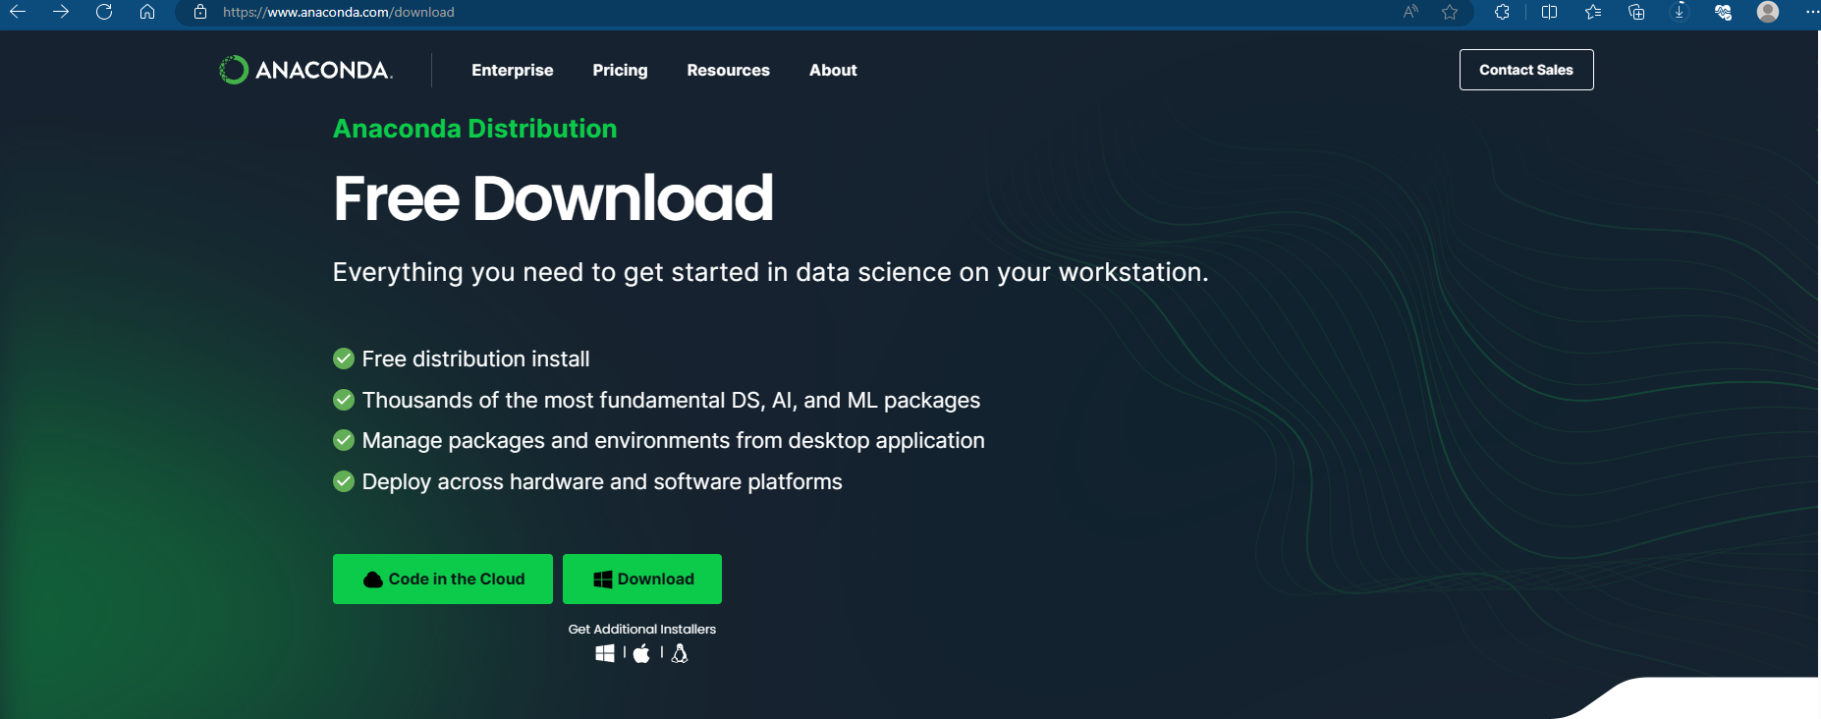
1. Download from this link Free Download | Anaconda

Slide 3
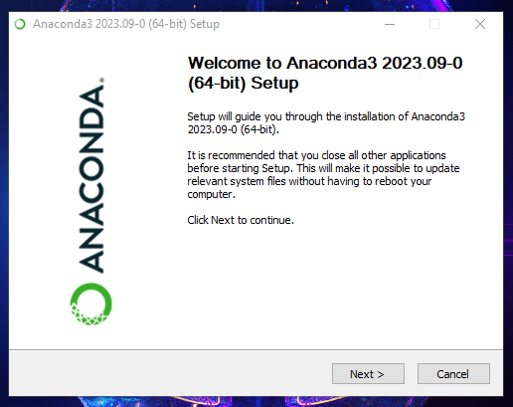

Slide 4
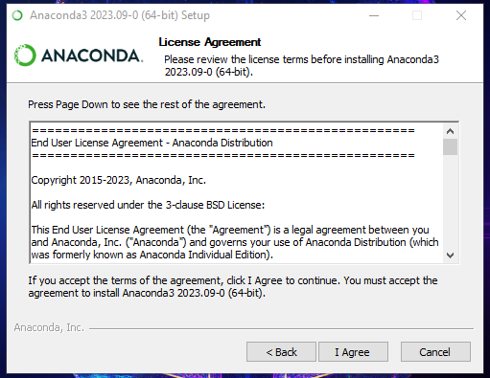

Slide 5
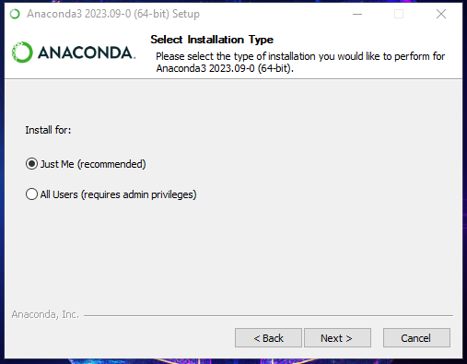

Slide 6
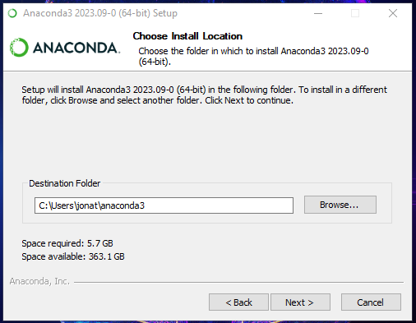

Slide 7
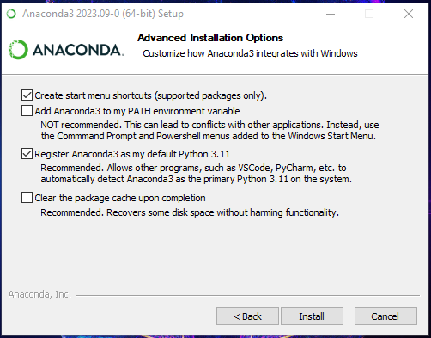

Slide 8
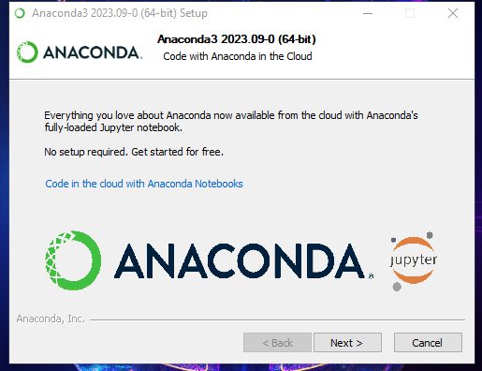

Slide 9
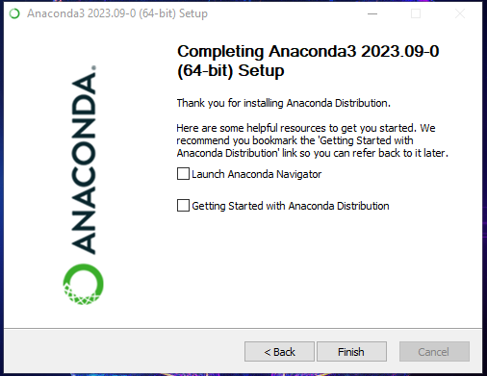

Slide 10
Working with Jupyter Notebook

Slide 11
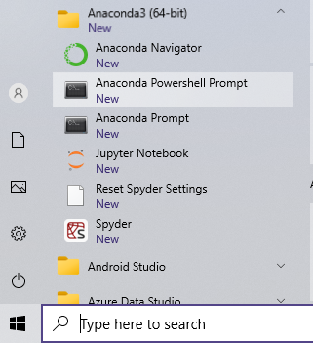

Slide 12
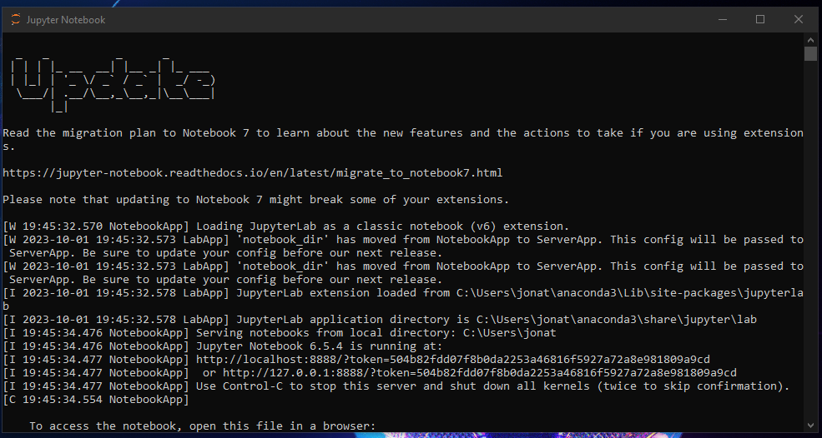

Slide 13
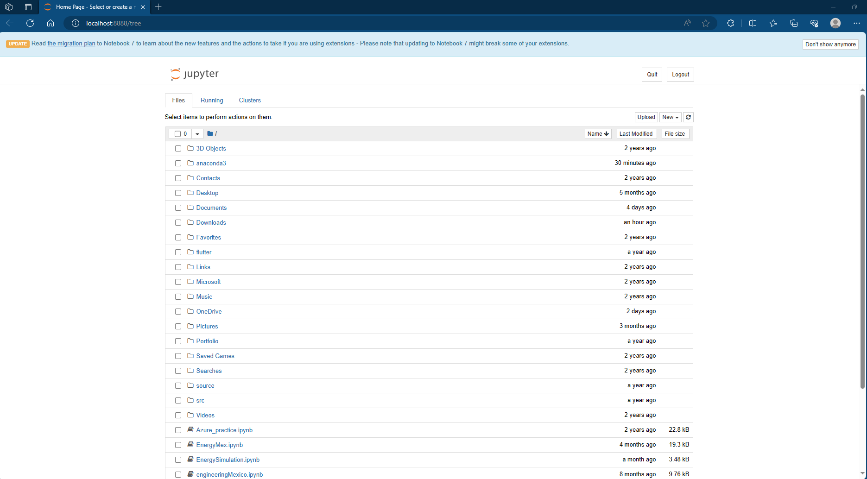

Slide 14
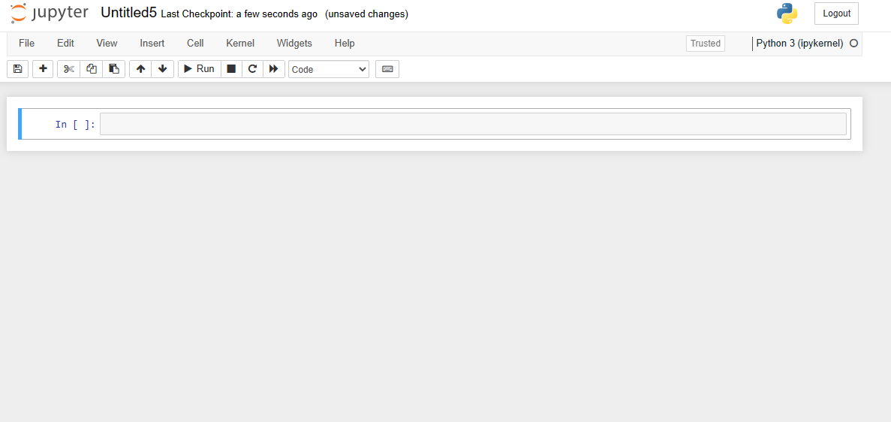

Slide 15
Useful resources
1. Markdown cheatsheet
Markdown Cheatsheet · adam-p/markdown-here Wiki · GitHub

